Slide 1

The Cortana Intelligence Suite
Microsoft R for the SQL Professional – Operationalizing and Deploying R Solutions
Microsoft Machine Learning and Data Science Team
CortanaIntelligence.com
Notes:
Main page: http://cortanaanalytics.com
To begin this module, you should have:
Basic Math and Stats skills
Business and Domain Awareness
General Computing Background
NOTE: These workbooks contain many resources to lead you through the course, and provide a rich set of references that you can use to learn much more about these topics. If the links do not resolve properly, type the link address in manually in your web browser. If the links have changed or been removed, simply enter the title of the link in a web search engine to find the new location or a corollary reference.

Slide 2

Learning Objectives
Know how to operationalize a SQL Server R Services environment
Use the Microsoft R capabilities in a solution
Notes:
At the end of this Module, you will:
Know how to operationalize a SQL Server R Services environment
Use the Microsoft R capabilities in a solution

Slide 3
The Data Science Process and Platform

Slide 4
The Team Data Science Process
Business Understanding
Define Objectives
Identify Data Sources
Data Acquisition and Understanding
Ingest Data
Explore Data
Modeling
Feature Selection
Create and Train Model
Deployment
Customer Acceptance
Operationalize
Testing and Validation
Update Data
Handoff
Re-train and re-score
Notes:
This process largely follows the CRISP-DM model: http://www.sv-europe.com/crisp-dm-methodology/
It also references the Cortana Intelligence process: https://azure.microsoft.com/en-us/documentation/articles/data-science-process-overview/
A complete process diagram is here: https://azure.microsoft.com/en-us/documentation/learning-paths/cortana-analytics-process/
Some walkthrough’s of the various services: https://azure.microsoft.com/en-us/documentation/articles/data-science-process-walkthroughs/
An integrated process and toolset allows for a more close-to-intent deployment
Iterations are required to close in on the solution – but are harder to manage and monitor
Data Science Blog: https://buckwoody.wordpress.com/

Slide 5
The Cortana Intelligence Platform
Cortana, Cognitive Services, Bot Framework
Power BI
HDInsight
Stream Analytics
Azure Machine Learning (MRS)
SQL Data Warehouse (SQL DB, Document DB)
Data Lake
Event Hubs
Data Factory
Data Catalog
Microsoft Azure
Notes:
Platform and Storage: Microsoft Azure – http://microsoftazure.com Storage: https://azure.microsoft.com/en-us/documentation/services/storage/ (Host It)
Azure Data Catalog: http://azure.microsoft.com/en-us/services/data-catalog (Doc It)
Azure Data Factory: http://azure.microsoft.com/en-us/services/data-factory/ (Move It)
Azure Event Hubs: http://azure.microsoft.com/en-us/services/event-hubs/ (Bring It)
Azure Data Lake: http://azure.microsoft.com/en-us/campaigns/data-lake/ (Store It)
Azure DocumentDB: https://azure.microsoft.com/en-us/services/documentdb/ , Azure SQL Data Warehouse: http://azure.microsoft.com/en-us/services/sql-data-warehouse/ (Relate It)
Azure Machine Learning: http://azure.microsoft.com/en-us/services/machine-learning/ (Learn It)
Azure HDInsight: http://azure.microsoft.com/en-us/services/hdinsight/ (Scale It)
Azure Stream Analytics: http://azure.microsoft.com/en-us/services/stream-analytics/ (Stream It)
Power BI: https://powerbi.microsoft.com/ (See It)
Cortana: http://blogs.windows.com/buildingapps/2014/09/23/cortana-integration-and-speech-recognition-new-code-samples/ and https://blogs.windows.com/buildingapps/2015/08/25/using-cortana-to-interact-with-your-customers-10-by-10/ and https://developer.microsoft.com/en-us/Cortana (Say It)
Cognitive Services: https://www.microsoft.com/cognitive-services
Bot Framework: https://dev.botframework.com/
All of the components within the suite: https://www.microsoft.com/en-us/server-cloud/cortana-intelligence-suite/what-is-cortana-intelligence.aspx
What can I do with it? https://gallery.cortanaintelligence.com/
Getting Started Quickly: https://caqs.azure.net/#gallery

Slide 6
Creating a Microsoft R Solution
https://mva.microsoft.com/ebooks/
Notes:
Complete introduction: https://msdn.microsoft.com/en-us/microsoft-r/microsoft-r-getting-started

Slide 7
Options
Script embedding
Azure ML
R Server
HDInsight
Microsoft SQL Server 2016
Notes:
Extended Events for SQL Server R Services: https://msdn.microsoft.com/en-us/library/mt628054.aspx

Slide 8
Microsoft R Services for SQL Server
Notes:
Great set of resources: https://www.r-bloggers.com/r-and-sql-server-articles/amp/
Using statistics in T-SQL :
https://curiousaboutdata.com/2016/11/21/associative-analytics-two-sample-t-test/
https://curiousaboutdata.com/2016/09/21/associative-statistics-one-sample-t-test-with-tsql-and-r/
https://curiousaboutdata.com/2016/09/13/statistics-chi-square-test/
https://curiousaboutdata.com/2016/09/05/statistics-with-t-sql-and-r-the-pearsons-correlation-coefficient/

Slide 9

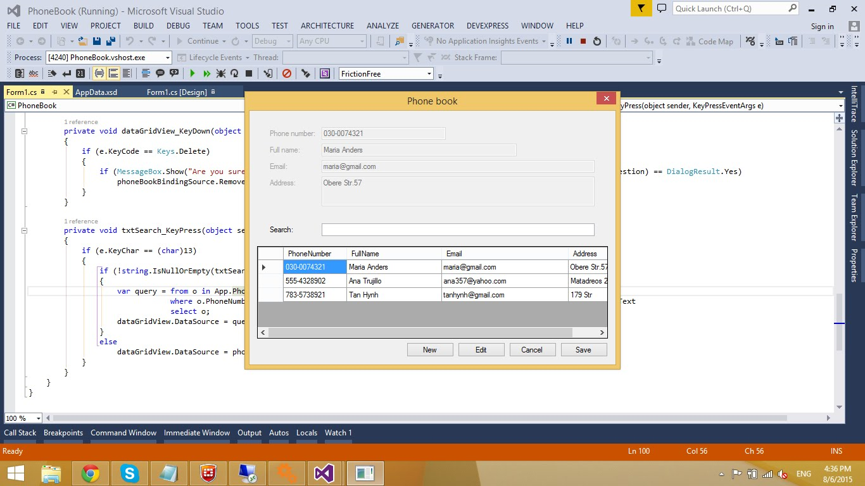
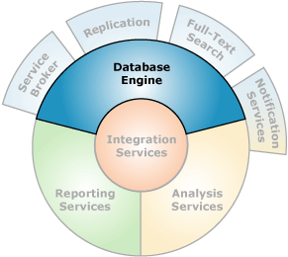
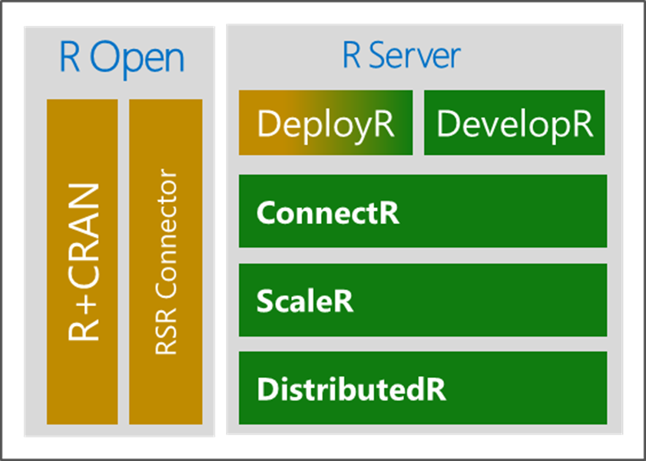
Microsoft R in SQL Server
Microsoft R Server
Launchpad
(BxlServer and SQL Satellite, Rserver.dll)
Notes:
Primary Documentation and training: https://msdn.microsoft.com/en-us/library/mt604845.aspx
Also add-ins for other services like SSIS: https://msdn.microsoft.com/en-us/library/mt146770.aspx
Data Science Blog: https://buckwoody.wordpress.com/

Slide 10
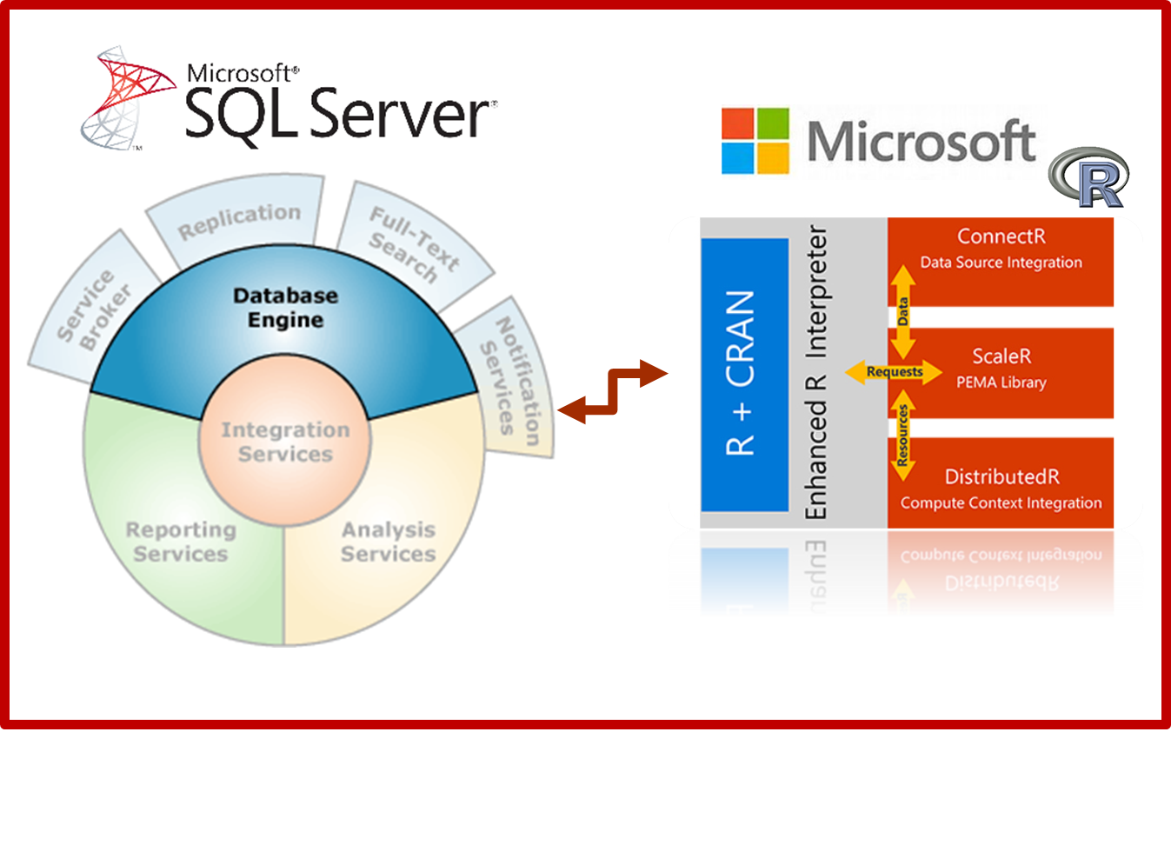
T-SQL and R Interaction
EXEC sp_execute_external_script
@language =N'R',
-- SQL Part (sends to @script)
@input_data_1 =N 'SELECT 1 as Installed',
-- R Part (gets @input_data_1)
@script=N'OutputDataSet<-InputDataSet'
WITH RESULT SETS
(([Installed] int not null));
GO
Notes:
Components and Architecture: https://msdn.microsoft.com/en-us/library/mt709082.aspx (with graphics)

Slide 11
Performance and Monitoring
Performance considerations
Monitoring
Tuning
Notes:
Extended Events for SQL Server R Services: https://msdn.microsoft.com/en-us/library/mt628054.aspx

Slide 12
Security and Governance
Principals
Securables
Notes:
Security Overview: https://msdn.microsoft.com/en-us/library/mt709078.aspx

Slide 13
Implementation Considerations
Coordinating with the R professional
Best Practices
Notes:
Managing and monitoring R Solutions for SQL Server: https://msdn.microsoft.com/en-us/library/mt590866.aspx
Upgrade and Installation: https://msdn.microsoft.com/en-us/library/mt653951.aspx
Considerations: https://msdn.microsoft.com/en-us/library/mt590540.aspx

Slide 14



Lab:
Using SQL Server R Services for Operationalizing a Solution
Notes:
Option 1: https://www.microsoft.com/en-us/sql-server/developer-get-started/r
Option 2: Open the SQL Server R Services Lab from your \Resources folder, follow the instructions you find there. Source Materials are at: https://github.com/Microsoft/sql-server-samples/tree/master/samples/features/r-services/Telco%20Customer%20Churn
Option 3: Refer to this link: https://gallery.cortanaintelligence.com/Tutorial/Predictive-Maintenance-Template-with-SQL-Server-R-Services-1 and work through that example.
Channel 9 Video on these tutorials: https://channel9.msdn.com/Shows/Cloud+Cover/Episode-226-Microsoft-R-Server-Solutions
More labs: https://github.com/Microsoft/SQL-Server-R-Services-Samples and https://gallery.cortanaintelligence.com/Collection/ML-Templates-with-SQL-Server-R-Services-1

Slide 15
Know how to operationalize a SQL Server R Services environment
Use the Microsoft R capabilities in a solution
Notes:
Questions?
More resources:
https://msdn.microsoft.com/en-us/microsoft-r/microsoft-r-more-resources
Revolutions Blog
Blog: Joseph Sirosh, “Making R the Enterprise Standard…”
Getting Started with Microsoft R
Diving In.. Data Analysis in Microsoft R
R Server Technology – Video
R Tools for Visual Studio Sneak Peek
R Tools for Visual Studio Overview
SQL R Services Overview – Youtube
SQL R Services Feature Overview - Youtube
SQL R Services Overview at Build
SQL R Services Tutorial

